Slide 1

Script of Scripts
Polyglot Notebook and Workflow System for both Interactive Multi-language Data Analysis and Batch Data Processing
Bo Peng, PhD
Department of Bioinformatics and Computational Biology
The University of Texas MD Anderson Cancer Center

Slide 2
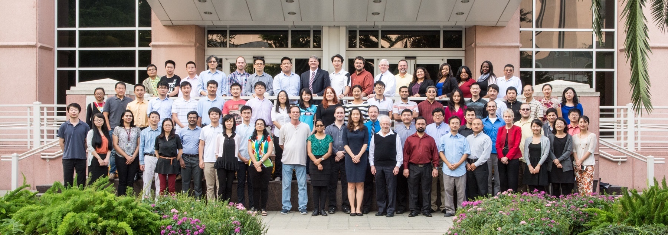
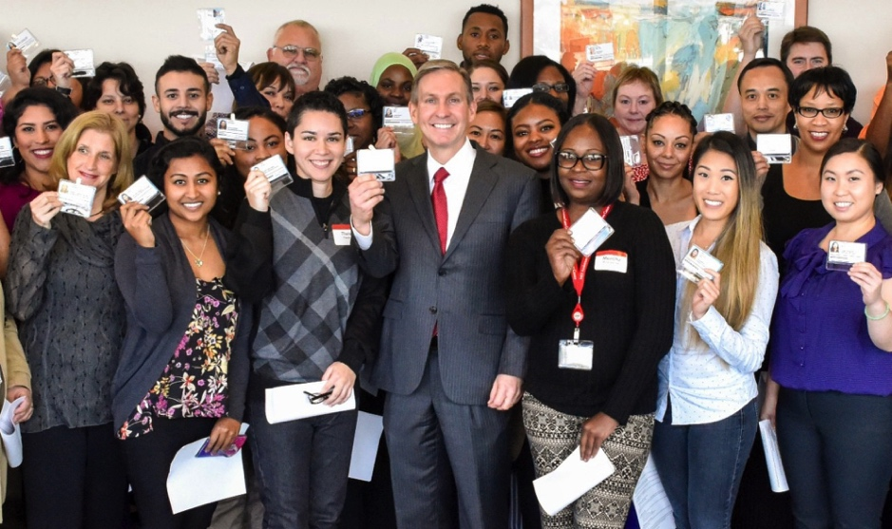
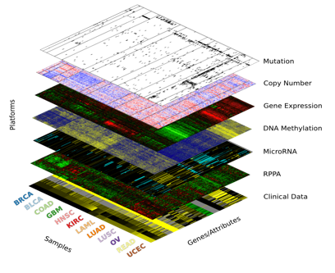
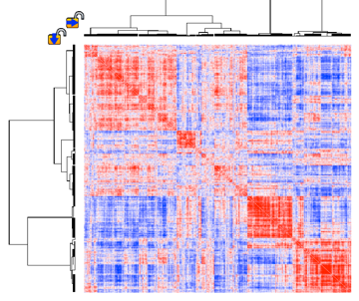
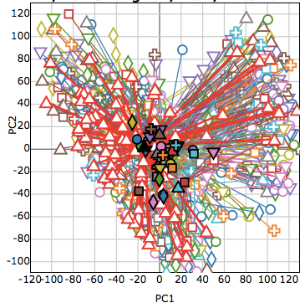
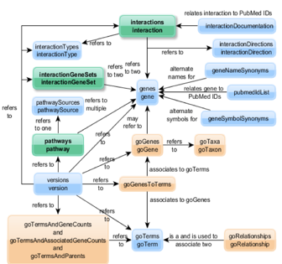
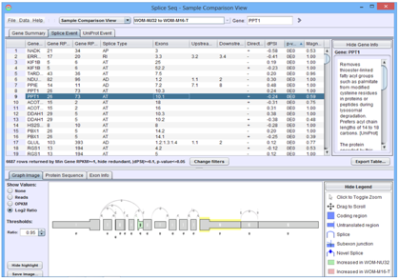
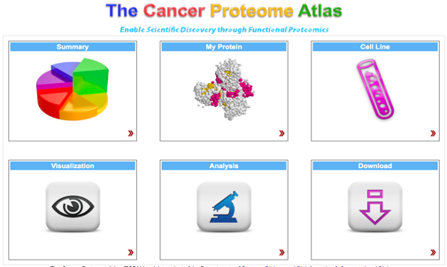
Who we are and what we do
Introduction
Notes:
A top-flight academic research program in bioinformatics -- in an MD Anderson Context
Top-flight bioinformatics support for MD Anderson programs
20 analysts, 15 faculty
6 software engineering team
122 authorships on 108 peer-reviewed publications
9.2 per faculty member
4.1 per Analyst
• NEJM (7), Cell (8), Nature (5), other Nature journals (6), Cancer Cell (4)
• Grants as PI (last 5 years): >$35 million
In 2016:
Worked on 376 projects for
122 Principal Investigators
In 50 MDACC departments

Slide 3








Our computational environment
Introduction
Notes:
Laptop, PC, servers, clusters
Data from core facility to cluster to server to notebook

Slide 4








workflow
Write and manage scripts written in different languages for different environments
Understand and reproduce others’ (and sometimes my own) projects
Manage data and workflows on different environments for batch data processing
Notes:
1 Management of scripts
2. Readability and reproducibility of workflows
3. Deploy jobs on clusters.

Slide 5
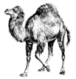

The promises of Jupyter ecosystem
Introduction
Supports virtually all scripting languages
Unified notebook format and interface
Flexible client/server architecture
JupyterHub for enterprise
JupyterLab was around the corner (now ready for users)
Binder for reproducible data analysis
Notes:
Workflows are counter-productive if they require you to use another environment even language

Slide 6
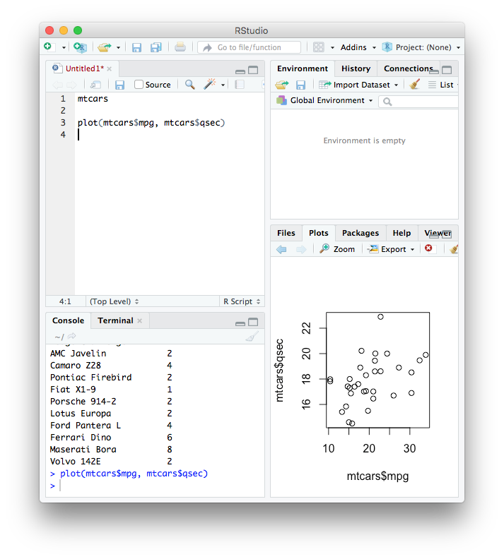
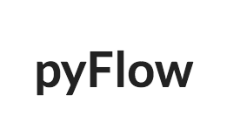
What was missing for our work?
Introduction
snakemake
More IDE features for interactive data analysis
Multi-language support
Integrated workflow system for batch data processing
Notes:
Jupyter is a bit behind as an IDE
Line-by-line execution *
Console window *
Variable inspector
Preview of files, figures etc
Separation of results from transient information (progress, debug message etc)
Jupyter supports only one kernel in a notebook
Limited support for multi-language data analysis (magics, inter-language modules)
Difficulties in notebook management, report generation etc if multiple notebooks are used
Jupyter is not designed for batch data processing
Limited support for computer clusters, remote execution, task monitor and management
Separate environments are needed to use workflow systems
Difficulties in converting Jupyter workflows to workflow systems
Michael Phelps vs Usain Bolt

Slide 7
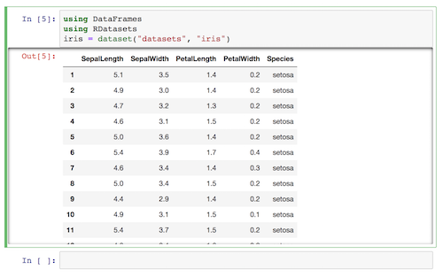

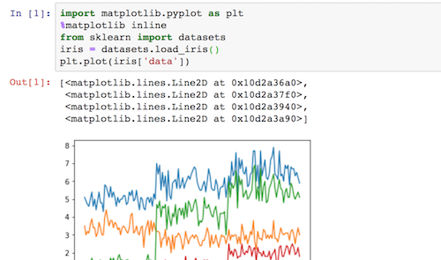

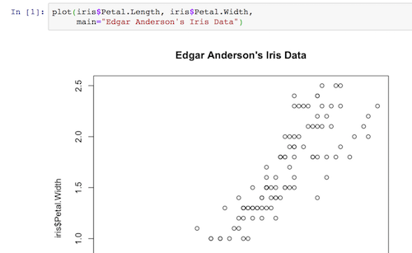

SoS Polyglot Notebook
Introduction
Notebook Server
Kernel
Notebook Server
Kernel
Notebook Server
Kernel

Slide 8
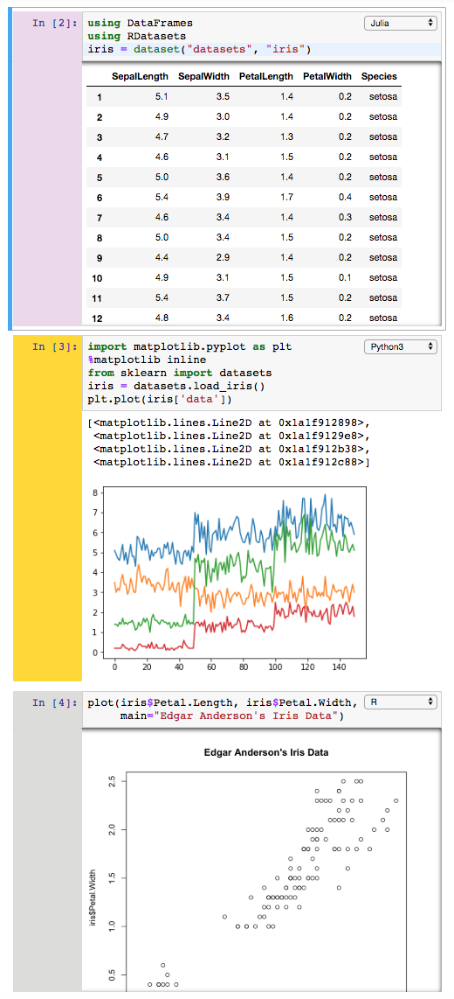
SoS Polyglot Notebook
Introduction
Kernel
Notebook Server
Kernel
Kernel
Kernel

Slide 9



Introduction
SoS Workflow System
Kernel
Notebook Server
Kernel
Kernel
Kernel
Workflow System

Slide 10
Polyglot Notebook
+
=
Polyglot Notebook
Workflow System
Working Environment
Notes:
Super kernel that supports all kernels, %expand and %capture

Slide 11
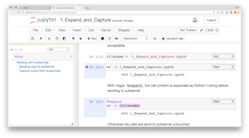
A super kernel to all jupyter kernels
Polyglot Notebook
Starts and shuts down subkernels
Receives input from frontend, (optionally) processes it, sends it to subkernels
Receives output from subkernels, (optionally) processes it, sends to frontend
Kernel
%expand
%capture
Subkernel
Notes:
Super kernel that supports all kernels, %expand and %capture

Slide 12
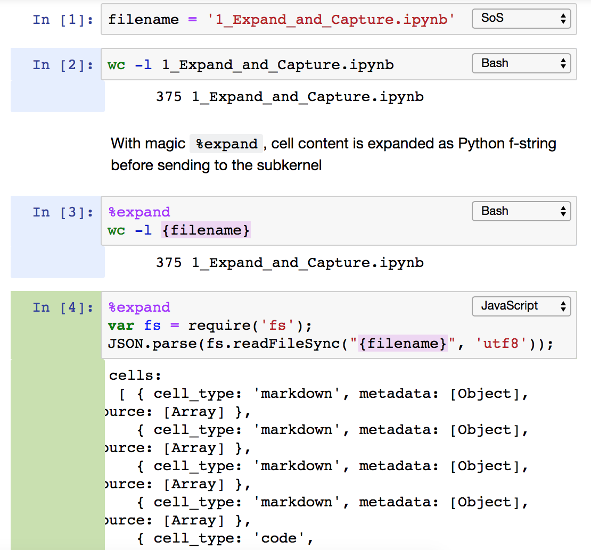
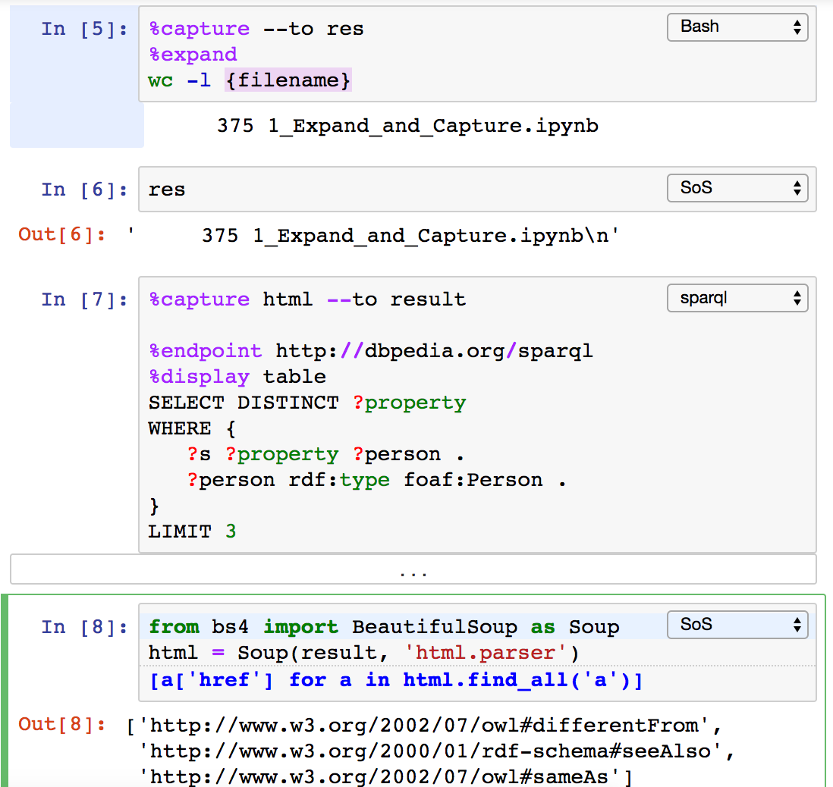
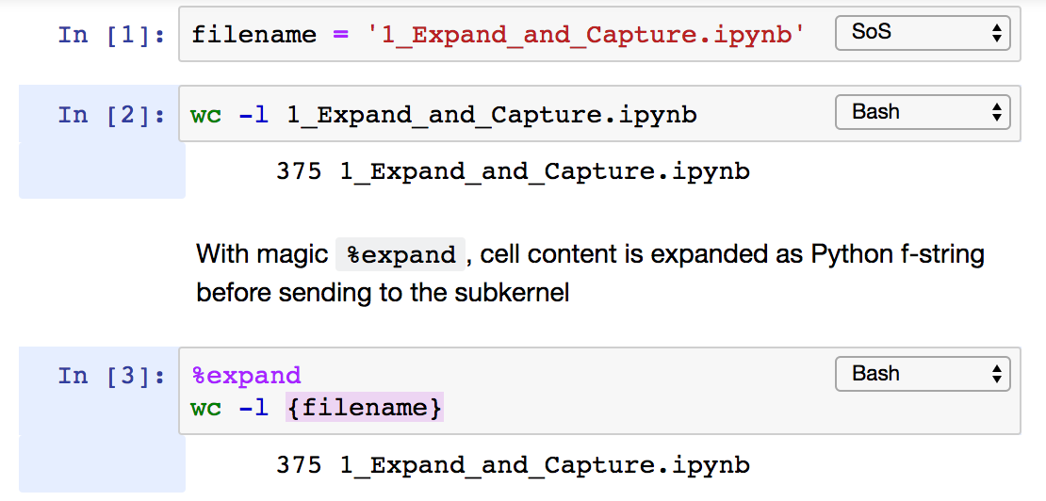
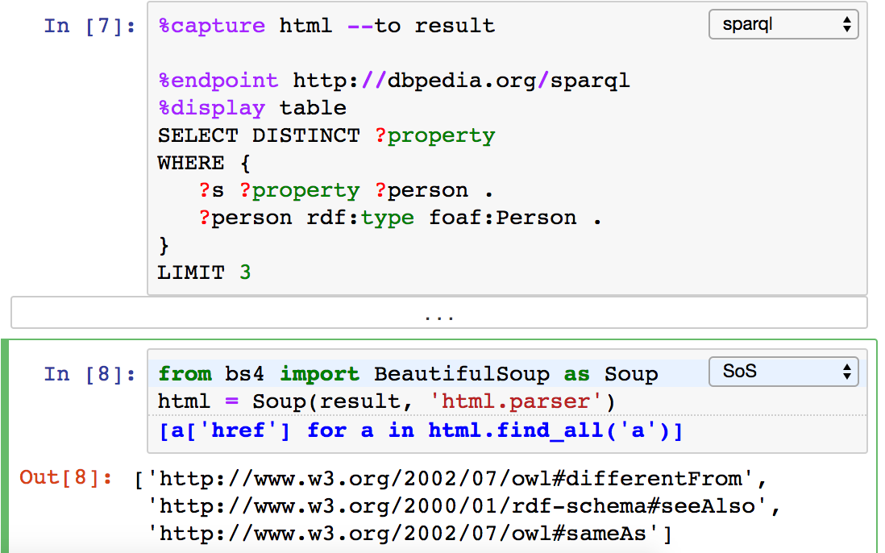
Prepare input and capture output of subkernels
Polyglot Notebook
Notes:
Super kernel that supports all kernels, %expand and %capture

Slide 13
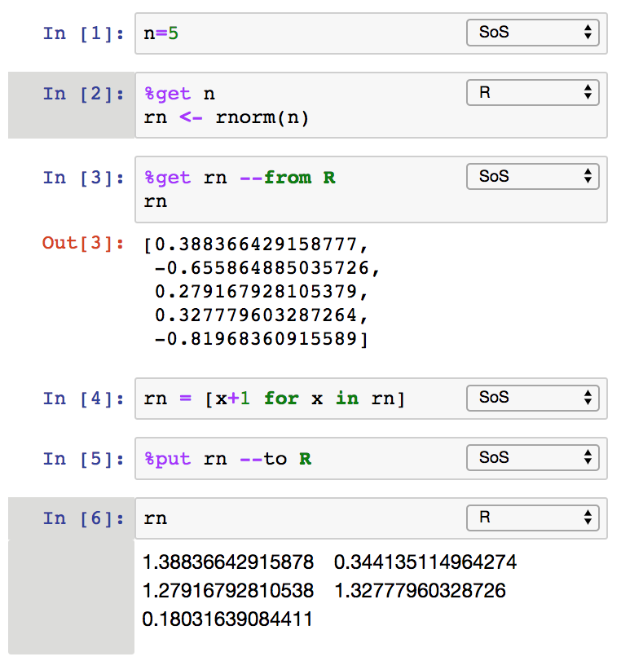
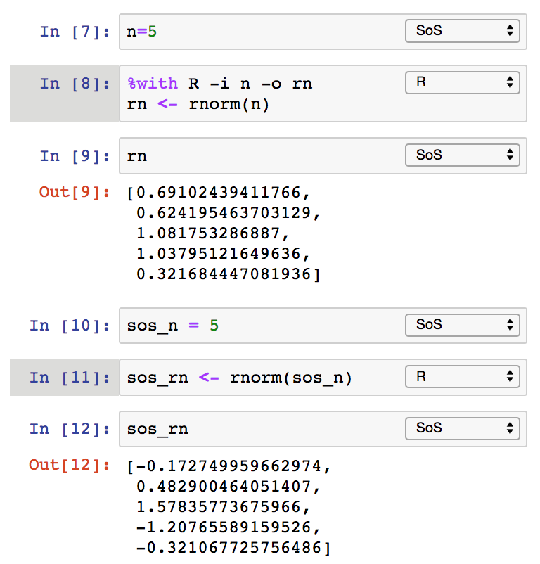
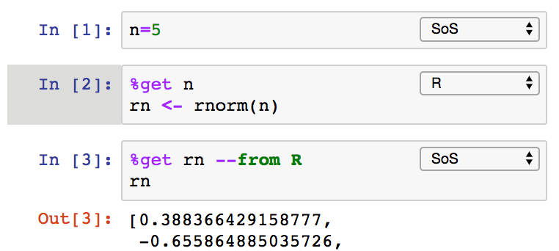
Data Exchange (magics %get, %put, and %with)
Polyglot Notebook
Notes:
Super kernel that supports all kernels, %expand and %capture

Slide 14
How data exchange works
Polyglot Notebook
arr: [1, 2, 3]
Kernel
df: pandas.DataFrame(…)
%put arr --to R
df = feather.read_dataframe(tmpfile)
write_feather(df, tmpfile)
arr <- c(1, 2, 3)
Kernel
%put df
arr: c(1, 2, 3)
df: data.frame(…)
Notes:
Super kernel that supports all kernels, %expand and %capture

Slide 15








Data exchange between SoS and supported subkernels
Polyglot Notebook
a=1
b=c(1,2)
Kernel
Create independent variables in another kernel
Direct data exchange between subkernels, or by way of SoS
Create variables of similar types
One to many (e.g. 1, c(1,2) in R)
Many to one (e.g. Char and str in Julia)
Intended to support a majority of datatypes, but with no guarantee of lossless data exchange
Supports kernels for 11 languages now
a=1
b=[1,2]
Kernel
c='x'
d='Hello'
Kernel
c='x'
d="Hello"
Notes:
Super kernel that supports all kernels, %expand and %capture

Slide 16
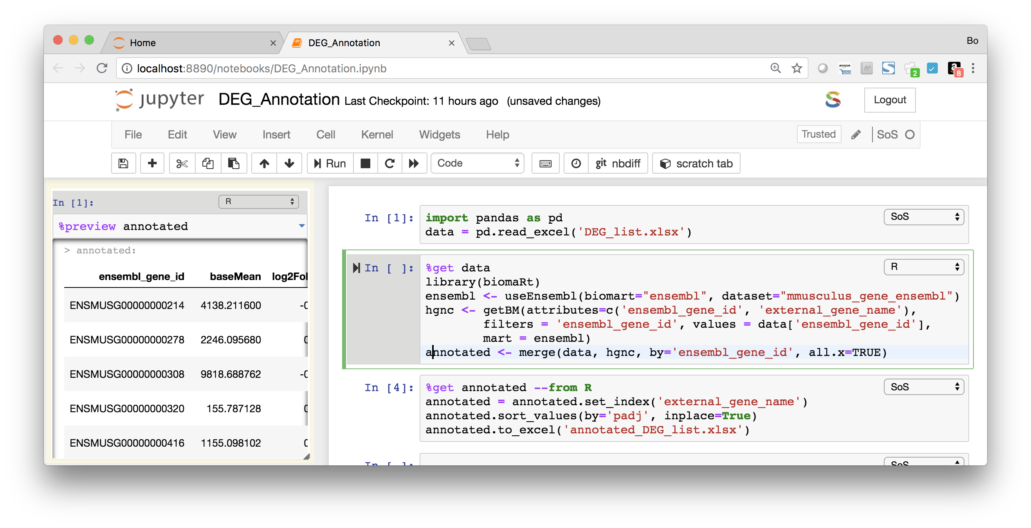
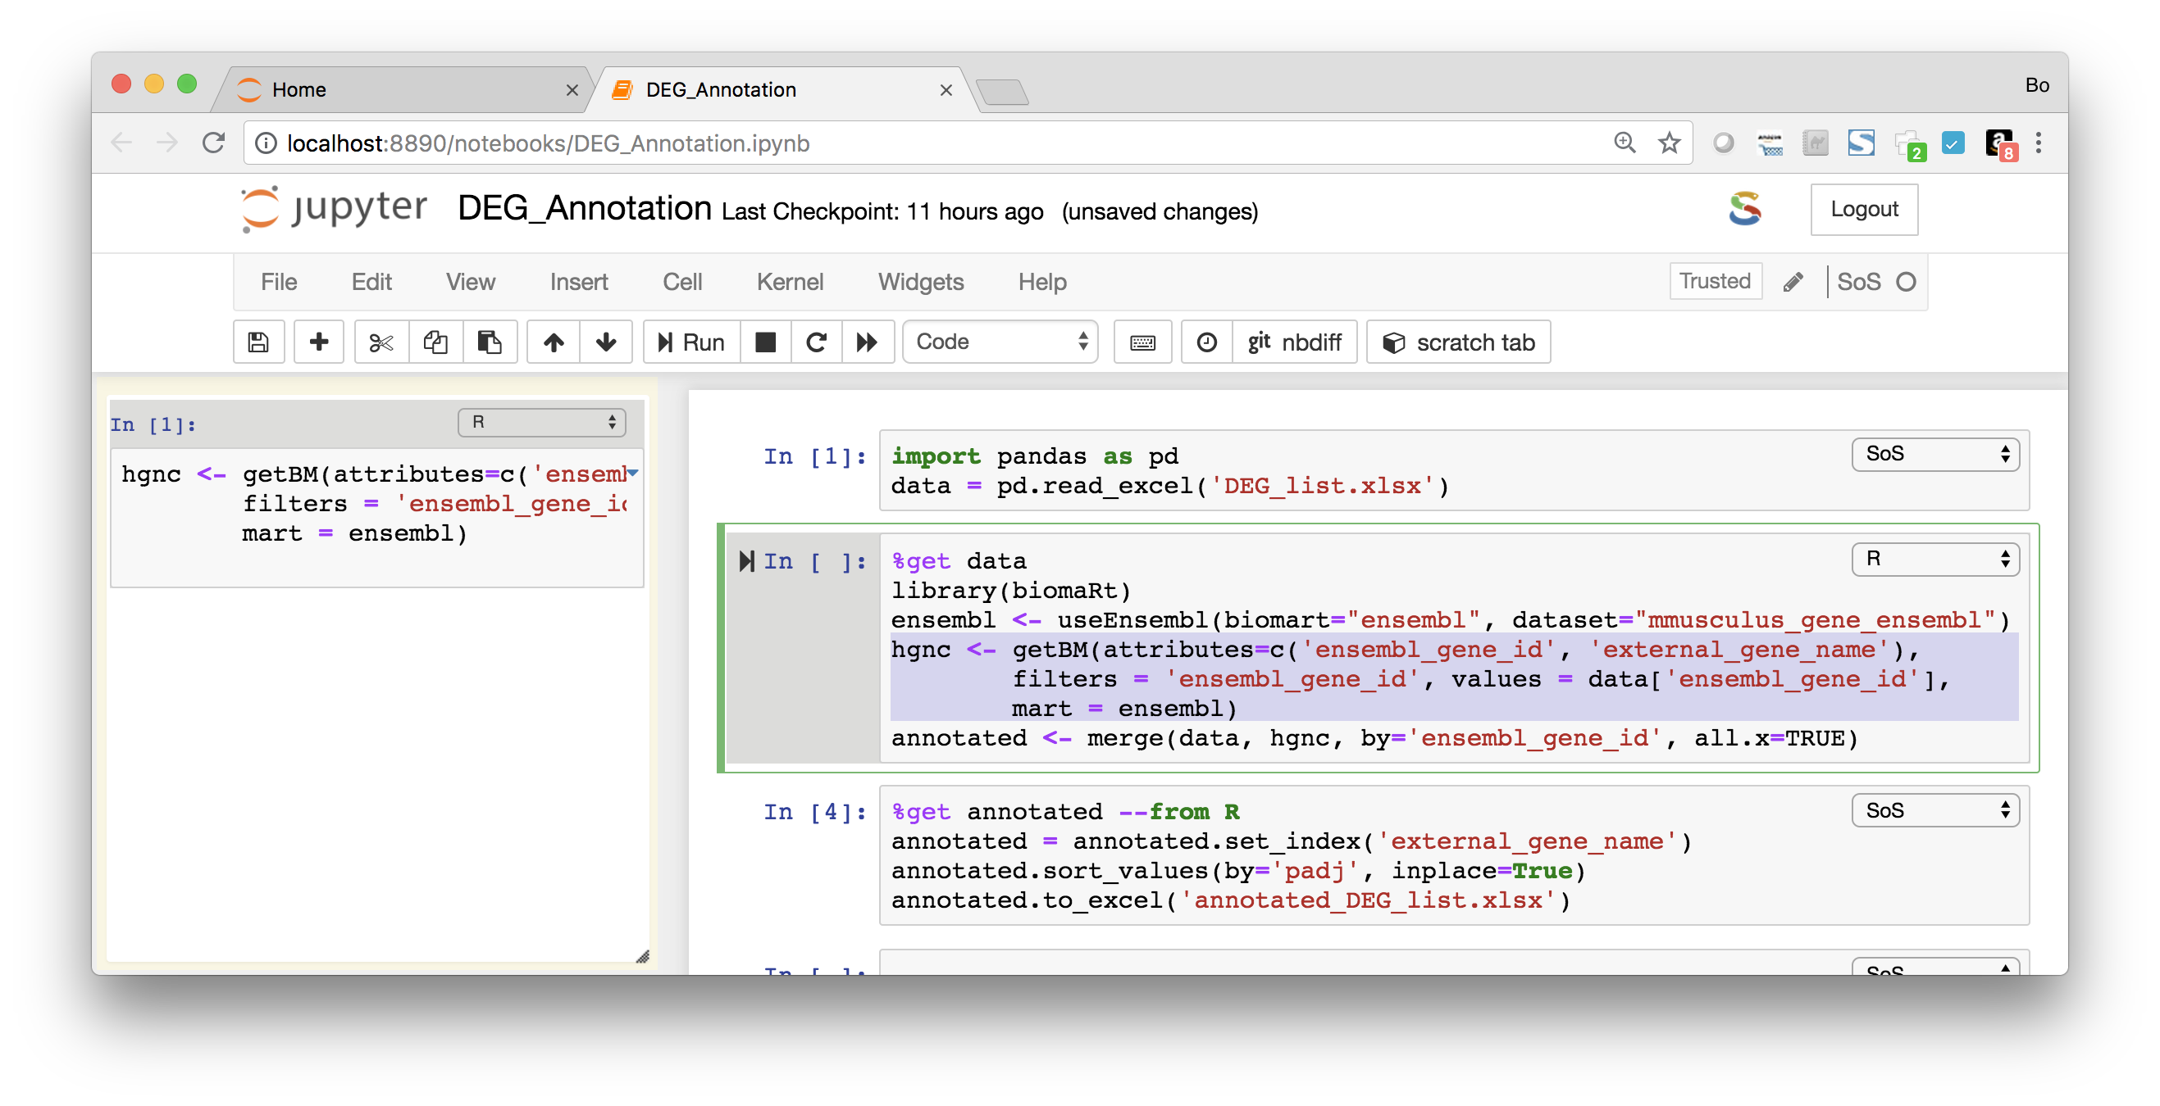
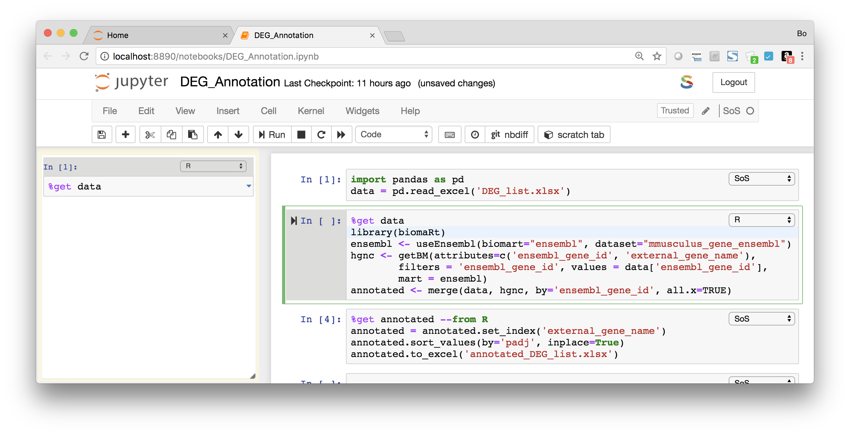
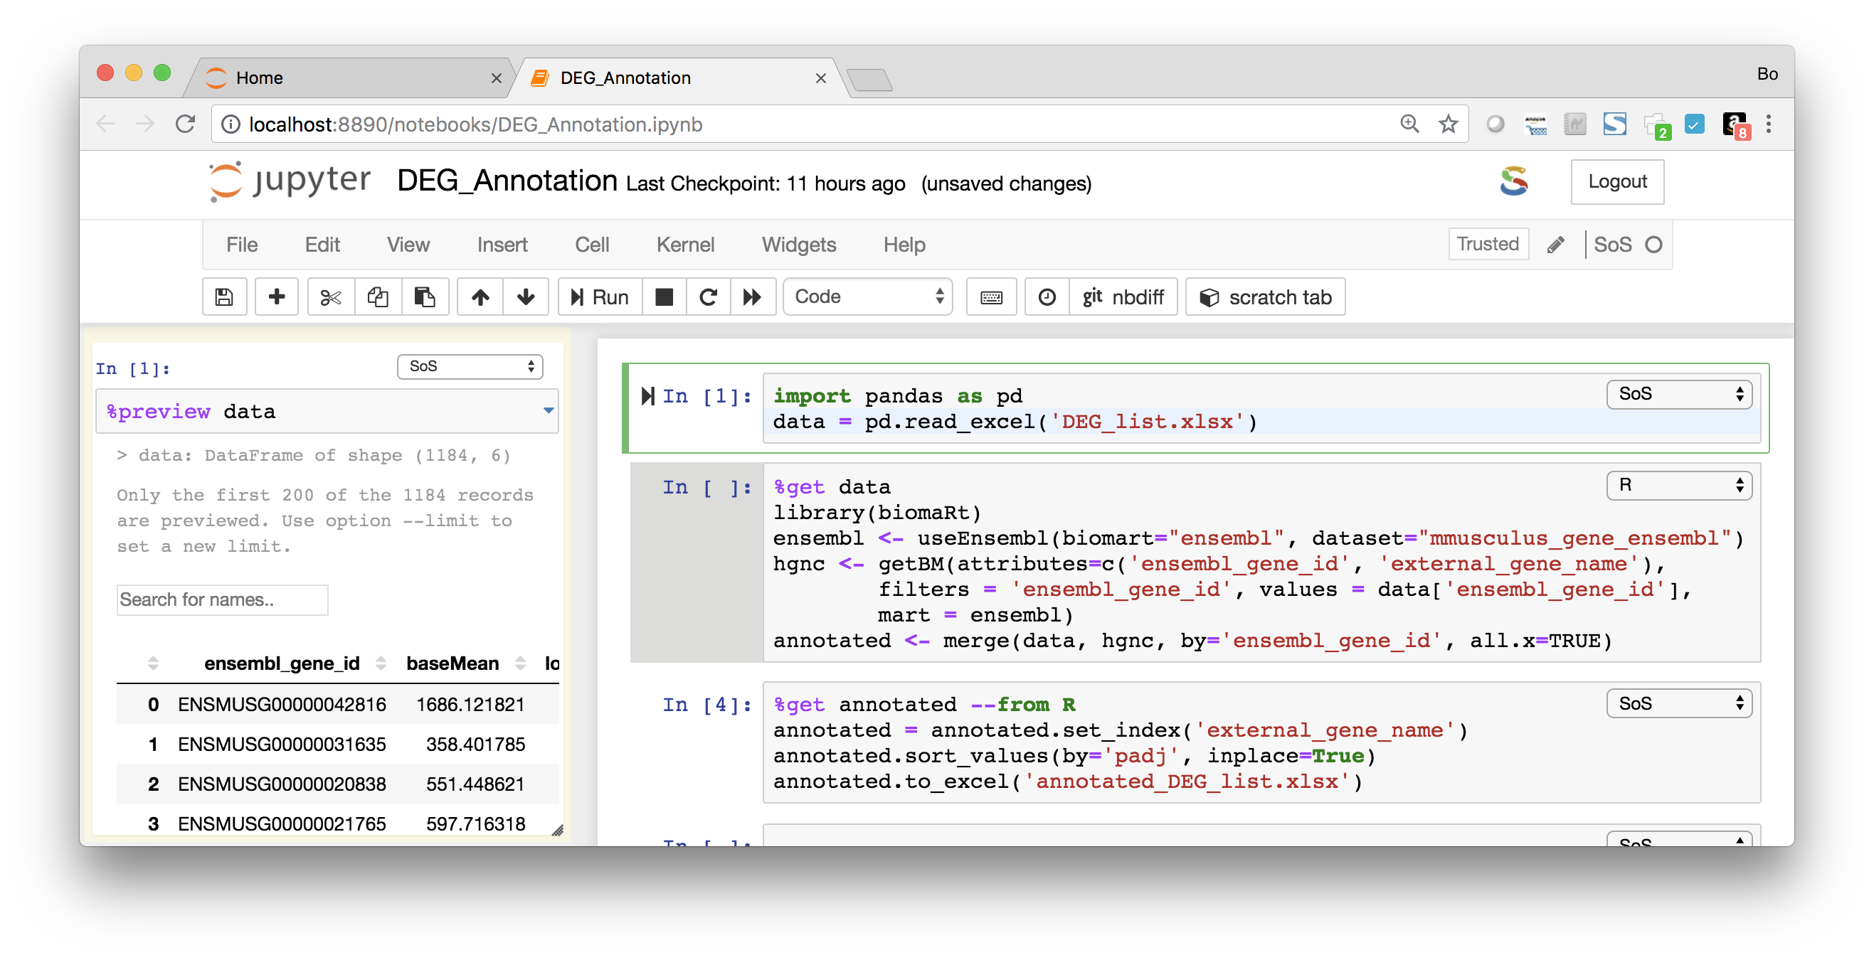
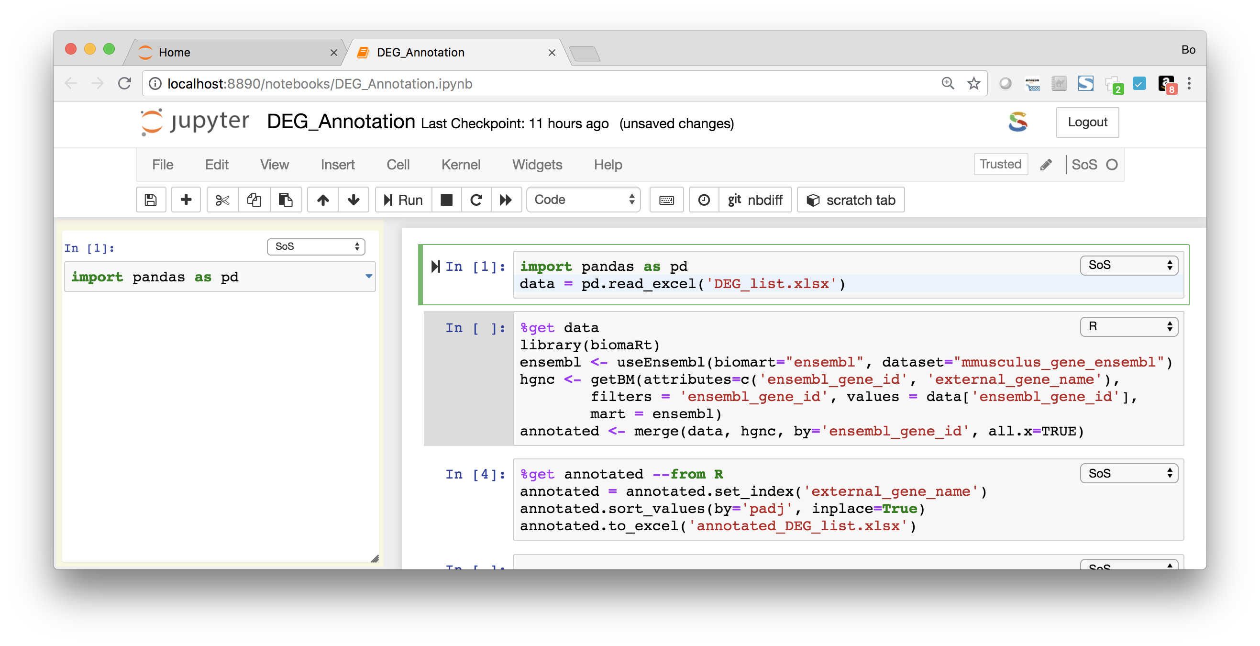
Line-by-line execution in side panel (Ctrl-Shift-Enter)
Polyglot Notebook
Command notebook:run-in-console is available in JupyterLab to execute code in a console panel, a default shortcut is not yet assigned.
Notes:
Q

Slide 17
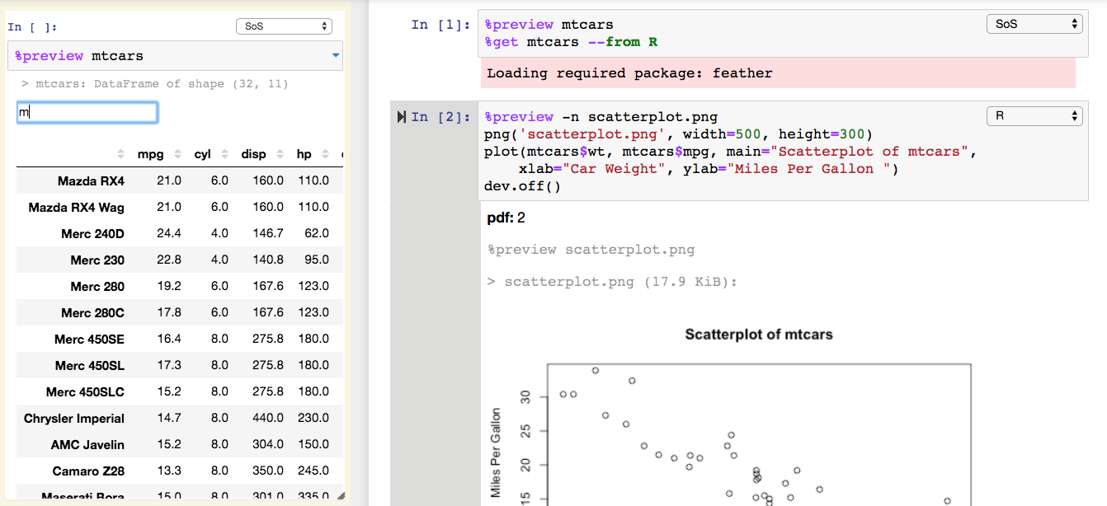
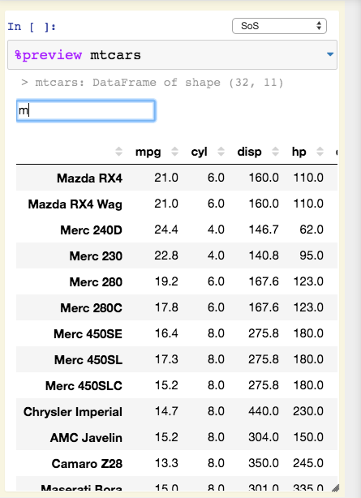
Preview of expressions and files
Polyglot Notebook
JupyterLab PR #4879 for displaying transient information from kernels is pending.
Notes:
Super kernel that supports all kernels, %expand and %capture

Slide 18
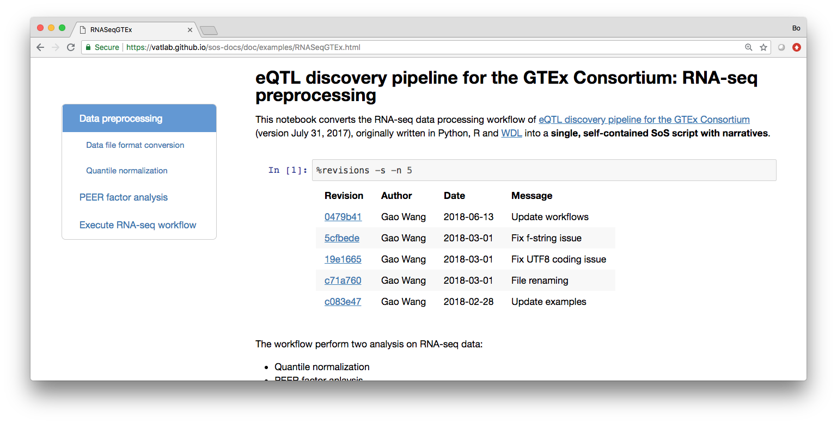
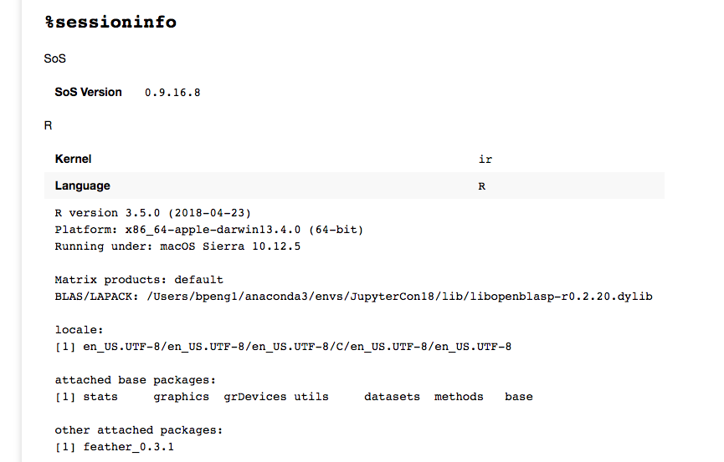
%revisions, %sessioninfo, and %sossave
Polyglot Notebook
%sossave is equivalent to sos convert from command line. Multiple templates are available.
Notes:
Q

Slide 19
Workflow System
+
=
Polyglot Notebook
Workflow System
Working Environment
Notes:
Q

Slide 20
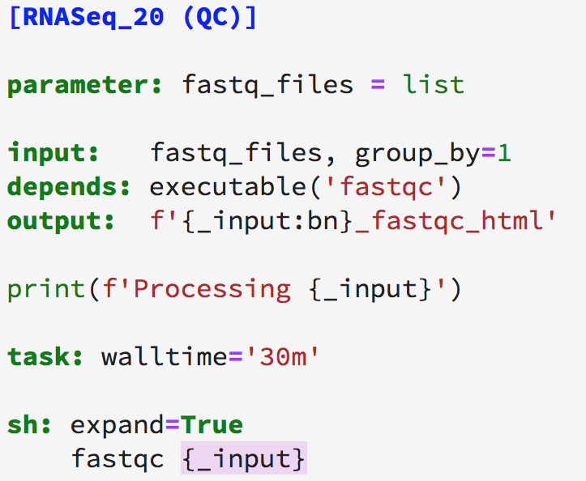
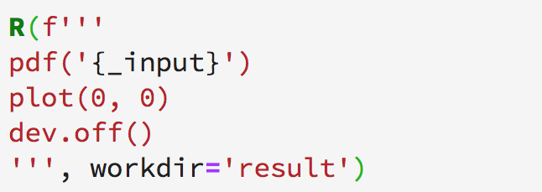
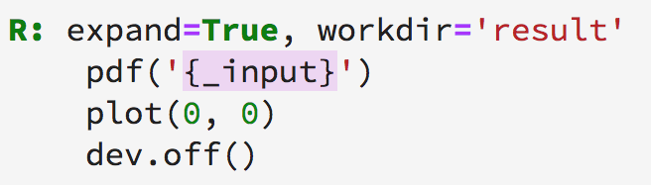
Overview of SoS Workflow Syntax
Workflow System
3.6+
Script format of function calls
Step header and statements
Function format
Script format
Headers define “steps” of workflows
input, output, and depends specify input, output and dependent targets of the step
task defines the rest of the step as external tasks
Indentation is recommended but not required
Alternative sigil is allowed (e.g. expand='${ }')
Notes:
Q

Slide 21
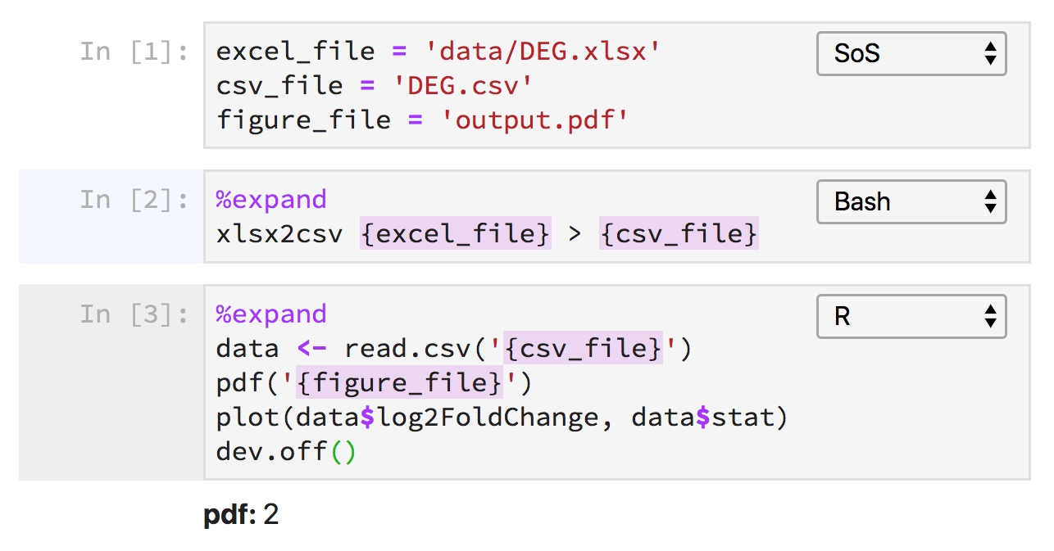
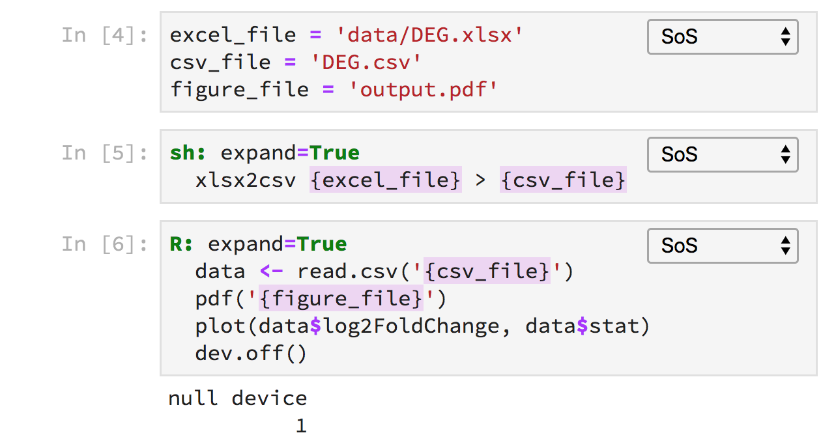
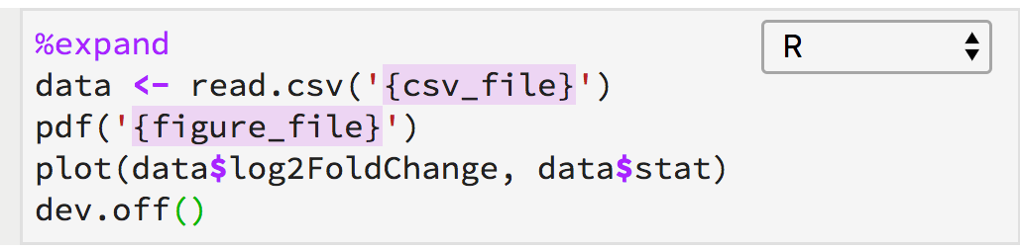
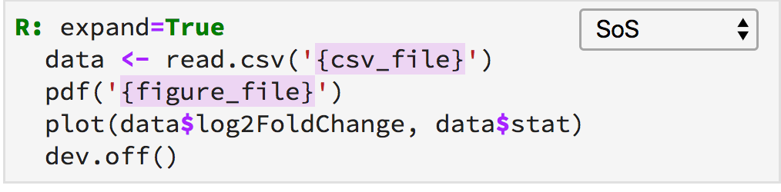
From subkernels to SoS kernel
Workflow System
Subkernels
Kernel
(possibly incomplete scripts)
(complete scripts)
Notes:
Q

Slide 22
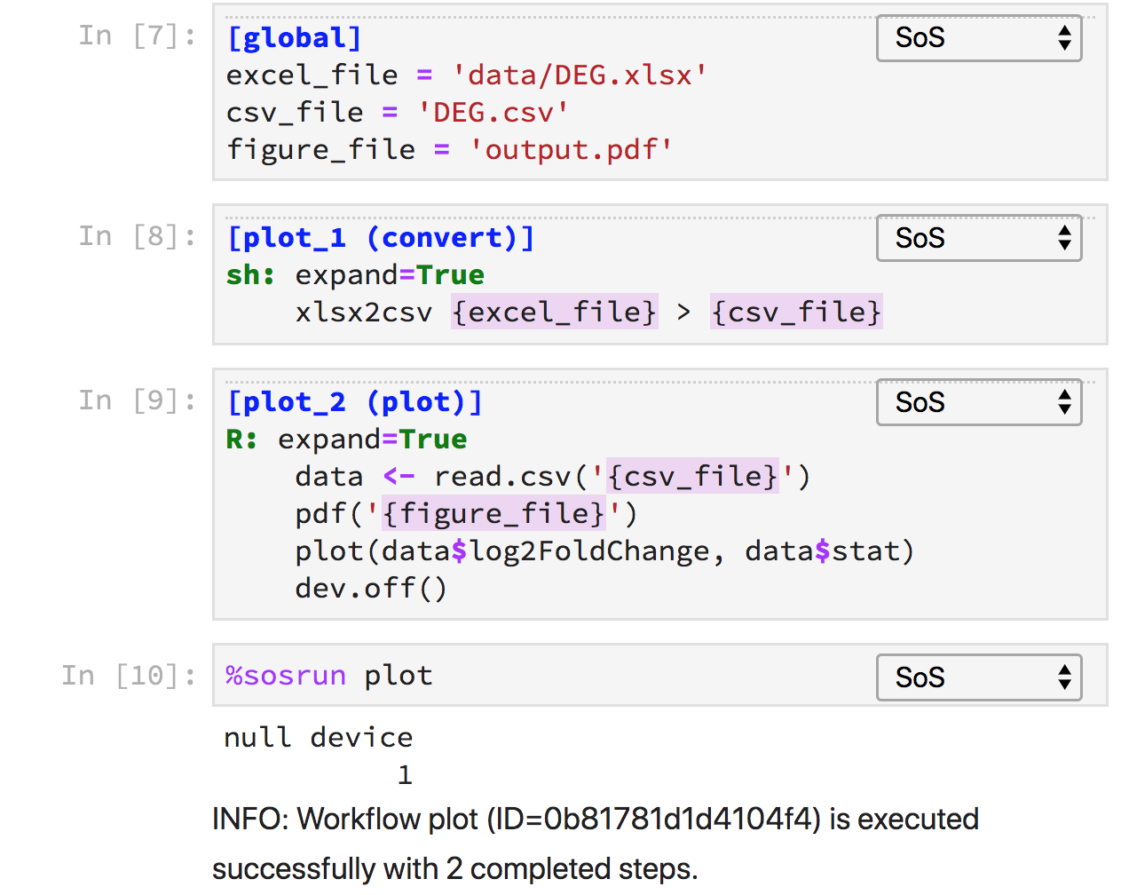
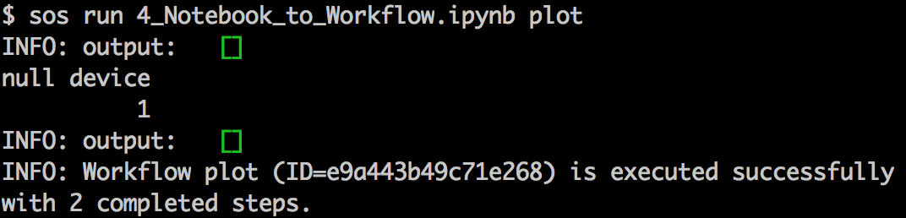
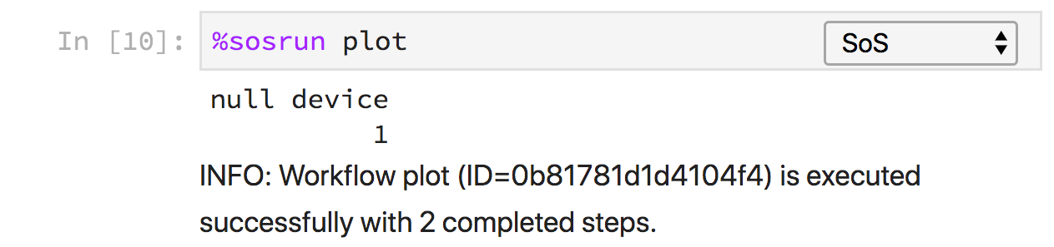
Embedded workflows in notebook
Workflow System
Kernel
Workflow
(shared kernel namespace)
(independent workflow namespace)
Notes:
Q

Slide 23
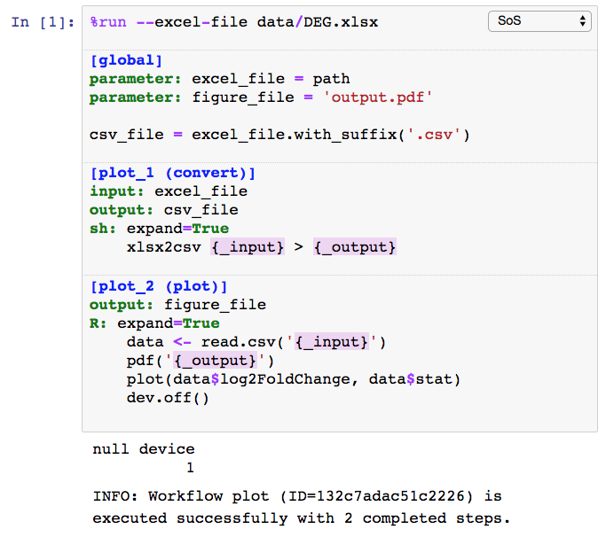
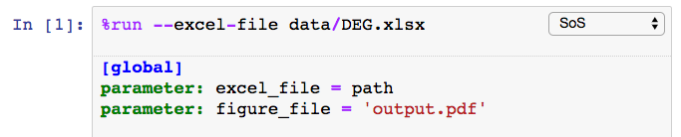
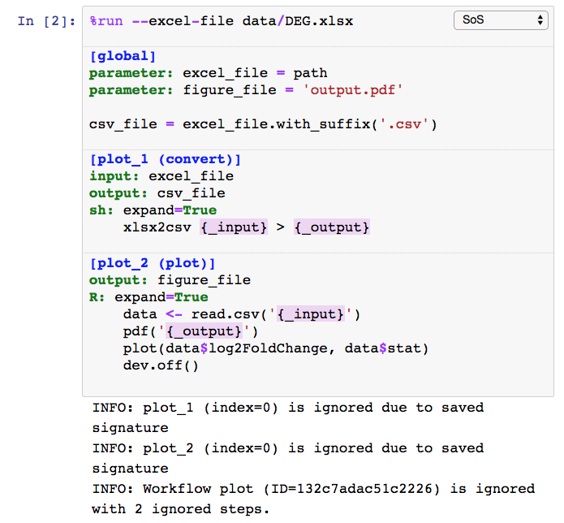
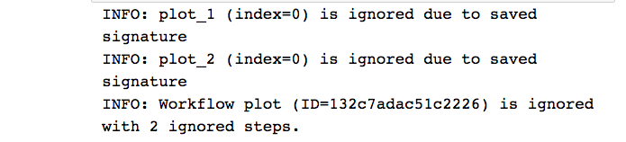
Parameters and runtime signatures
Workflow System
Notes:
Q

Slide 24
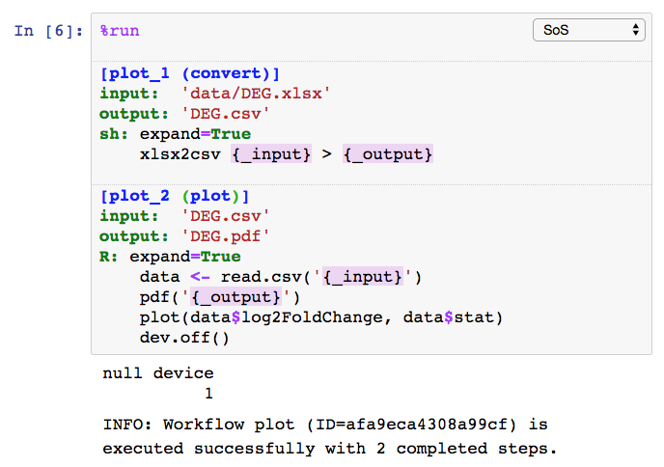
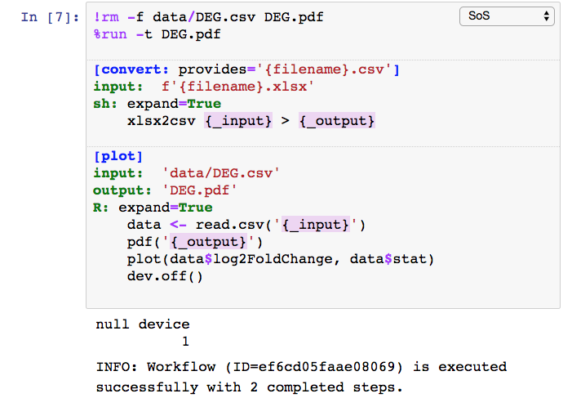
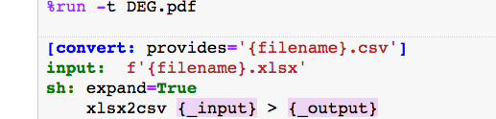
Process-oriented vs outcome-oriented workflows
Workflow System
Numerically numbered steps of a “process”
Execute sequentially (logically)
Steps can provides targets for others
Workflow constructed to generate specified targets (option –t)
Notes:
Q

Slide 25
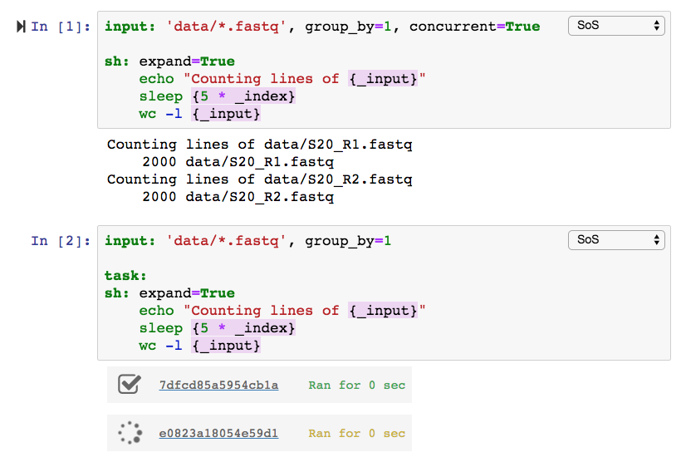


Concurrent execution and external tasks
Workflow System
Notes:
Q

Slide 26





SoS task model
Workflow System
77e3c2ef7079a236.task
c:\Project\f1.fastq
c:\Project\f1.bam
input: “c:\Project\f1.fastq”
output: “c:\Project\f1.bam”
sh: expand=True
some_command_to_process {_input}
hosts.yml
77e3c2ef7079a236.task
/Project/f1.fastq
input: “/home/bpeng/Project/f1.fastq”
output: “/home/bpeng/Project/f1.bam”
sh: expand=True
some_command_to_process {_input}
77e3c2ef7079a236.sh
/Project/f1.bam
#PBS –N 77e3c2ef7079a236
#PBS –l nodes=1:ppn=1:mem=10G
#PBS –l walltime=24:00:00
cd /home/bpeng1/Project
sos execute 77e3c2ef7079a236
Notes:
Q

Slide 27

Execute scripts in docker containers
Workflow System
Notes:
Q

Slide 28



DAG and workflow reports
Workflow System
Notes:
Q

Slide 29
Summary
+
=
Polyglot Notebook
Workflow System
Working Environment
Notes:
Laptop, PC, servers, clusters
Data from core facility to cluster to server to notebook

Slide 30
Our previous computational environment
Summary
Notes:
Laptop, PC, servers, clusters
Data from core facility to cluster to server to notebook

Slide 31
Our new computational environment
Summary
Notes:
Laptop, PC, servers, clusters
Data from core facility to cluster to server to notebook

Slide 32

SoS notebooks for reproducible data analysis
Summary
+
=
Polyglot Notebook
Workflow System
Working Environment
Multi-language data analysis with data exchange
Side panel and magics for interactive data analysis
Powerful Python-based multi-style workflow system
Remote execution of external tasks
Environment for both interactive data analysis and batch data analysis
Reproducible notebooks

Slide 33
















SoS Status
Summary
https://vatlab.github.io/SoS
https://github.com/vatlab
License:
sos 0.16.9
sos-notebook 0.16.10
jupyterlab-sos 0.2.4
Languages:
Browser:
OS:
Jupyter:
Task queue:
Container:
bpeng@mdanderson.org
ScriptOfScripts
https://vatlab.github.io/blog

Slide 34



Acknowledgements
Summary
Gao Wang (U Chicago)
Jun Ma
Man Chong Leong
Chris Wakefield
James Melott
Yulun Chiu
Di Du
Dr. John Weinstein
Dr. Christopher Amos (BCM)
Dr. Paul Scheet
Dr. Suzanne Leal (BCM)
Grant R01HG008972
Grant 1R01HG005859 (Dr. Paul Scheet)
CPRIT RP130397
Gordon and Berry Moore Foundation (#4559)
The Michael and Susan Dell Foundation
The Chapman Foundation

Slide 35


Summary
https://vatlab.github.io/sos/live

